Slide 1
List Comprehension in Python
DVT101 – Lecture 29
- By Dataverse Tutorials

Slide 2
What is List Comprehension?
Meaning of list comprehension
One-line list creation concept
Transformation + filtering in one expression
Cleaner alternative to loops

Slide 3
Why List Comprehension is Powerful
Less code, more clarity
Avoids temporary variables
Faster execution than loops
Used heavily in Data Science

Slide 4
Basic Structure of List Comprehension
Expression part
Iteration logic
Optional condition
How each part connects

Slide 5
How It Works Internally
Iteration happens in memory
Expression applied to each element
New list creation process
Comparison with loop execution

Slide 6
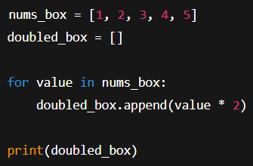
For Loop vs List Comprehension
Lines of code comparison
Readability difference
Performance intuition
When loop is still useful

Slide 7

Simple Transformation Concept
Mapping one list to another
Example: square, double, convert types
Real-life data transformation analogy

Slide 8
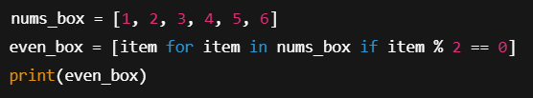
Conditional Filtering Concept
Using condition inside comprehension
Filtering unwanted data
Business rule examples
Cleaner than nested loops

Slide 9
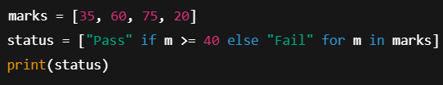
If–Else in List Comprehension
Conditional expression logic
Two-way decision inside list
Handling default cases
Data cleaning use case

Slide 10

Using Range with Comprehension
Auto-generated sequences
Loop replacement
Index-based generation
Simulation datasets

Slide 11

Nested List Comprehension
Multiple loops in one expression
Grid and matrix style data
Cartesian product logic
Advanced use-case

Slide 12
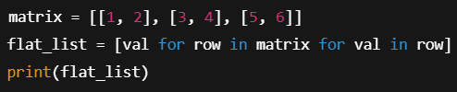
Flattening Nested Lists
Converting matrix to vector
Data preprocessing stage
Removing nested structure
ML pipeline usage

Slide 13
Readability vs Over-Optimization
When list comprehension becomes complex
Trade-off between clarity and speed
When to avoid nested chains

Slide 14
Performance Perspective
Fewer bytecode operations
Faster execution
Memory efficiency
Loop overhead comparison

Slide 15
Common Mistakes
Too much logic in one line
Missing condition placement
Confusing nested order
Debugging difficulty

Slide 16
Real-World Use Cases
Feature engineering
Log data filtering
API data transformation
ML dataset preprocessing

Slide 17
Best Practices
Keep expressions simple
Break complex logic
Use meaningful variable names
Prefer clarity

Slide 18
Career Relevance
Data Analyst workflows
Machine Learning pipelines
Automation scripts
Interview importance

Slide 19
Comparison with Other Tools
Map + filter
Generator expressions
When list comprehension is best

Slide 20
When NOT to Use It
Deep nested logic
Heavy condition chains
Large memory constraints

Slide 21
Summary & Key Takeaways
One-line transformation
Faster and cleaner
Industry standard practice
Master for productivity

Slide 22


